Slide 1
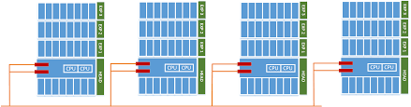
DevOps & Cloud Infrastructure SEIS 665 Week 3
Jason Baker
Adjunct Instructor
Graduate Programs in Software
University of St. Thomas
St. Paul, MN

Slide 2
Agenda
Distributed infrastructure
Virtualization
Vagrant

Slide 3
What is distributed infrastructure?
A computing architecture where software components are running on multiple systems.

Slide 4
Why do we need it?
You probably only need one computing device if you are the only one using a software app.
Mobile phone, laptop, tablet, etc.
What if your software needs to support hundreds, thousands, or millions of users?
Need to support multiple transactions simultaneously.
You can’t buy a server big enough to support all your users.
A single system provides no redundancy if it fails.

Slide 5
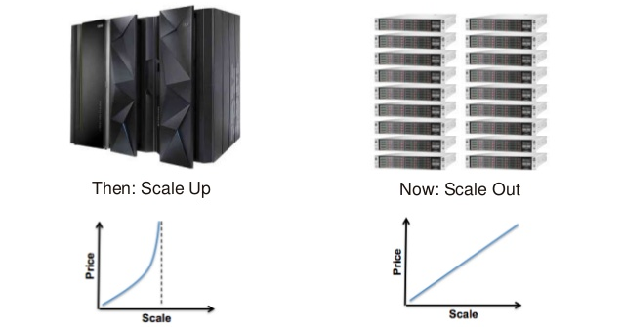
How do we support more users?

Slide 6
Scale Up vs. Out
Example: Single large webserver vs. many small webservers.
Single large server | Multiple small servers
Easy to maintain | Difficult to maintain, need to sync content and handle performance differences
Finite amount of processing, memory & I/O | Unlimited* amount of processing, memory & I/O
Requires no special application support. | Application needs to support distributed deployment architecture (stateless, ephemeral, etc.)
* Nothing is really unlimited ☺

Slide 7
Distributed infrastructure patterns
Building a distributed infrastructure architecture is fundamentally different.
May need to support thousands or millions of users.
Need to route user requests to the appropriate server.
Need to distribute and partition data across many systems.
Need to provide fault tolerance to deliver a reliable service.

Slide 8
Distributed infrastructure patterns
Need to provide fault tolerance using software rather than hardware.
Traditional applications run on a single server which must be incredibly reliable.
Distributed applications leverage cheap commodity hardware which is relatively unreliable.
We need to create an infrastructure architecture that delivers reliable application services on unreliable systems.

Slide 9
Distributed infrastructure patterns
A bit about patterns…
A pattern is a common architectural model which generally meets specified requirements or solves a problem.
An anti-pattern is an architectural model which generally leads to an unsatisfactory outcome.
Most anti-patterns started out as patterns, but then because anti-patterns when requirements changed.

Slide 10
Distributed infrastructure patterns
4 useful distributed infrastructure patterns:
Load balancer with backend servers
Proxy systems
Server trees
Database sharding

Slide 11
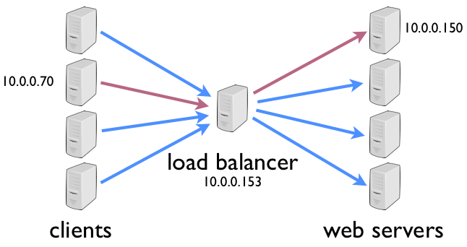
Distributed infrastructure patterns
Load balancer with backend servers
LB takes an incoming request and routes it to one of many servers.
Example: User web browser request is routed to a webserver.
LB watches the health of servers and dynamically re-routes requests to maintain high availability

Slide 12
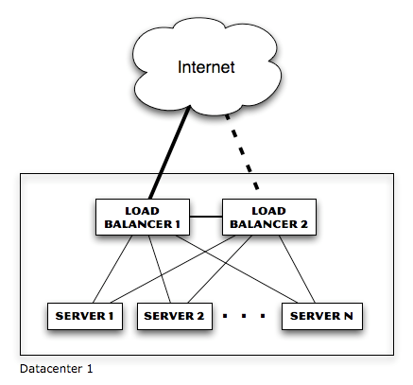
Distributed infrastructure patterns
LB eliminates single-point-of-failure with servers, but what about LB itself?
Now we need redundant LB (and switches and firewalls and routers…)

Slide 13
Distributed infrastructure patterns
A load balancer can use a variety of algorithms to determine which server handles a request.
Random: each incoming request is sent to a random server in the pool
Round-robin: each incoming request is sent to a different server in a predetermined order
Can also be accomplished with DNS settings and is sometimes referred to as spray-and-pray.

Slide 14
Distributed infrastructure patterns
Least load: Load balancer monitors load of each server and sends requests to least loaded system
Problem? What if least loaded system is actually malfunctioning in some way the LB cannot detect.
Least loaded system could be quickly overwhelmed because average load metrics lag behind requests.
Solution = slow start.
Weighted round robin: servers are given specific weights so that higher-weighted servers receive a greater percentage of requests.
Maybe some servers are more powerful than others.

Slide 15
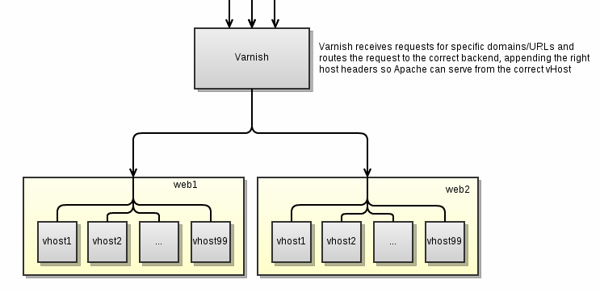
Distributed infrastructure patterns
Server with multiple back-ends (proxy service)
Server partitions a request into multiple queries to various backend systems and then aggregates responses.
Response impacted by highest latency response.
Fan-in I/O challenges

Slide 16
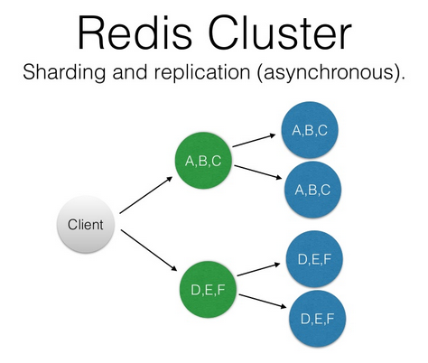
Distributed infrastructure patterns
Server tree
Commonly used by distributed databases.
Found in services like Active Directory and DNS.
Main benefit is parallelization and reduced request latency.

Slide 17
The distributed state challenge
State refers to data that an application needs to persist (store) for a long duration.
Large distributed systems need to persist data.
A single database server will eventually run out of processing power, memory, or storage.
Facebook can’t store all their data on a single server.
Solution: Need to store data on multiple database servers.

Slide 18
Database Sharding
How do we store data across multiple database servers?
Partition a database into multiple slices, called shards.
Shards are stored on multiple servers.
A server may contain one or more shards.
Apps distribute requests to multiple sharded database servers, improving performance for some operations.
Improved write and indexing performance.
Potential challenges rebalancing data on shards.

Slide 19
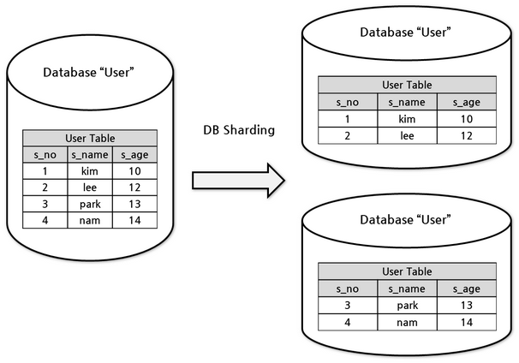
Database Sharding

Slide 20
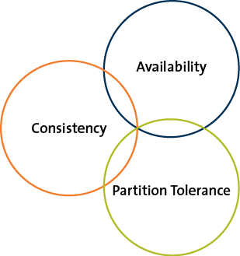
CAP Principle
The CAP Principle describes a fundamental limitation associated with distributed databases.
Presented by Eric Brewer in 1999.
It is not possible to build a distributed system that guarantees consistency, availability, and partition tolerance.
You can only pick
2 of the 3!

Slide 21
CAP Principle
Consistency
All nodes see the same data at the same time.
Two consistency options:
Application waits until all server nodes are updated (slow – strong consistency).
Application reads data from an available server knowing data might be outdated (fast – eventual consistency)
Apps where transactions are significant, like banks, need strong consistency.
Apps where speed is more important than data recency, like social media, leverage eventual consistency.

Slide 22
CAP Principle
Availability
Means that the data is accessible when an app makes a request.
We spread and replicate data on multiple servers to guarantee availability.
Can an application on a single server be available? Sure, but a single server isn’t a distributed architecture. ☺

Slide 23
CAP Principle
Partition tolerance
The system continues to operate despite the failure of part of the system.
Classic failure scenario: network link is severed between groups in a pool of servers, creating a partition (split-brain scenario).
Can’t maintain consistency because writes to one partition cannot be communicated to other.

Slide 24
CAP Principle
Q: Why is understanding CAP important?
A: Because it informs our design decisions when persisting data in distributed infrastructure.
Consistency & Availability = MySQL
Consistency & Partition Tolerance = MongoDB
Availability & Partition Tolerance = DynamoDB

Slide 25
NoSQL
NoSQL = Not only SQL.
Goal is to store data closer to the way it’s actually represented.
Several different types of NoSQL databases, each solving different scaling issues.
Growth of NoSQL correlated to the growth of distributed systems (~2010).

Slide 26
NoSQL
Four major types of NoSQL databases:
Key/value
Columnar
Document
Graph

Slide 27
Key/value database
Key/value
Store a key/value set.
Query a key and get a value returned
Based on hashing algorithm & easy to shard.
Popular way to store web user sessions
Key = sessionId
Value = serialized session object
Examples: Redis, memcached

Slide 28
Columnar database
Columnar
Imaging pivoting a traditional database table.
Store columns instead of storing columns in sequential disk pages.
Offers super-fast aggregate operations.
What’s the total profit across all products in the company?
Examples: Hbase, Redshift

Slide 29
Columnar database

Slide 30
Document database
Document
Store documents instead of individual atomic records.
Each document is stored in the form of Javascript Object Notation (JSON).
Supports hierarchical and embedded data structures.
A person can have many addresses, each address is embedded in the document.
Sometimes called schema-less databases (but that’s not necessarily true).
Examples: MongoDB, DynamoDB

Slide 31
Document database

Slide 32
NoSQL types
Graph
Stores data in nodes and edges of a graph
Able to easily store and maintain complex relationships (social media)
Example Neo4j
If you are interested in NoSQL, take the Big Data Management course (SEIS 737).

Slide 33
Distributed system coupling
You learned about the concept of coupling in the software engineering course.
In general, loose coupling is desirable.
Easier to maintain and replace components.
Fewer bugs and hidden dependencies.
More flexible.
Loose coupling is highly desirable in distributed systems as well.
We’ll look at application components like message buses which help to reduce coupling later in the semester.

Slide 34
Scaling performance
The speed of small systems cannot easily be translated to large distributed systems.
Applications running on a single server will encounter different bottlenecks as the service scales.
Doubling CPU or memory does not necessarily double performance.
The performance bottleneck (constraint) always changes!
Network and disk I/O are orders of magnitude slower than CPU and memory access.
Be very wary of these kinds of requests!
Slow request latencies are magnified at scale.

Slide 35
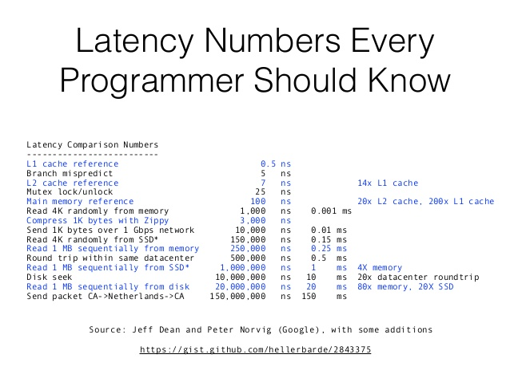

Slide 36
Virtualization
A stack: combination of infrastructure, OS, and applications required to support a service.
Before early 2000’s, a stack = 1 server + 1 OS
Software applications
Operating System
Compute/Storage

Slide 37
Virtualization
We can create software with emulates hardware.
Manipulating memory in the right patterns and sequences allows us to create operating systems and applications.
Allows us to run multiple infrastructure stacks (os + apps) on a single physical computing system.
Multiple stacks are logically partitioned from a process, memory, and networking perspective.

Slide 38
Virtualization solves problems
Servers are turned into software.
It’s easier to move software around.
Easy to move a stack from an older physical server to a newer physical server.
No need to purchase a separate server for each user or team because virtualization provides partitioning.

Slide 39
Virtualization definitions
First, some definitions:
Host machine: physical server that supports multiple stacks.
Virtual machine: virtualized server instance running on a host machine (also known as an instance or a workload).
Host OS: operating system running on a bare-metal server.
Guest OS: operating system running on a virtual machine.
Hypervisor: Software that emulates and manages the communication between virtual machines and the physical server.

Slide 40
Virtualization Types
Hardware virtualization
Part of physical server dedicated to a specific stack.
Big expensive mainframe-type systems

Slide 41
Virtualization Types
Software virtualization
Type 1 Hypervisor
Runs on top of the bare-metal server and sits between hardware and operating systems in the stacks.
Examples: VMWare ESX, Microsoft Virtual Server, Xen
Type 2 Hypervisor
Runs on top of an operating system.
Easy installation (no special hypervisor or storage required).
Example: Oracle VirtualBox, VMWare Fusion

Slide 42
Type 1 vs. Type 2 Hypervisor

Slide 43
Virtualization Types
Type 1 vs. Type 2
Type 1 provides higher performance & security.
Full virtualization vs. Paravirtualization
Full virtualization = guest operating systems are not “aware” that they are being virtualized.
Paravirtualization = guest operating system are “aware” of virtualization and have special kernel modifications.
better performance than full virtualization in past years

Slide 44
Virtualization Types
OS Partitioning
Host (or guest) operating system can partition out processes, memory, and scheduling to emulate a separate OS environment.
Separate OS environments all use same kernel.
If host is Linux then all “guests” are Linux.
Example: Docker containers
We will cover this later in the course. ☺

Slide 45
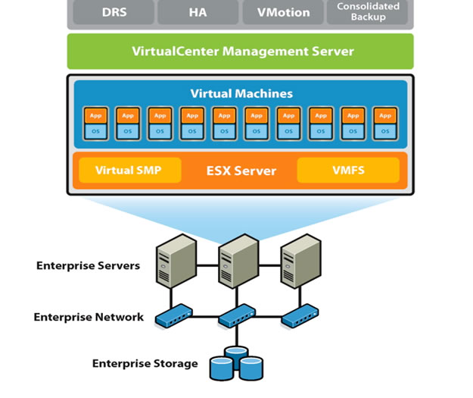
Virtualization infrastructure
Server virtualization is the predominant form of virtualized infrastructure.
Most servers in enterprises are now virtualized.
Gartner estimates up to 75% of workloads are virtualized.
New virtualization software licenses have declined for first time in over a decade.

Slide 46
Virtualization infrastructure
Other forms of virtualized infrastructure:
Virtual Desktop Infrastructure (VDI)
Storage virtualization: pooling together storage devices from disparate vendors and presenting as a single storage device.
Network virtualization: replace physical switches, routers, load balancers and firewalls with software (AWS VPC).
Software Defined Networking (SDN)
Software Defined Infrastructure (SDI)

Slide 47
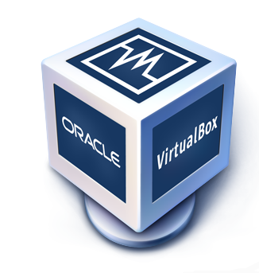
VirtualBox
Hypervisor for x86 systems originally developed by Innotek, acquired by Sun, acquired by Oracle.
Core package is open source, extensions are licensed by Oracle for personal/educational use.
Not quite as fast as commercial offerings like VMWare Fusion, but good enough for dev/testing.

Slide 48

Virtual Box Hands On
Create Linux virtual machine.
Add Xubuntu disk image to virtual optical drive.
Power on new VM.

Slide 49
Virtual machine challenges
Creating virtual machines is time-consuming, repetitive, and mistake prone.
Imagine needing to stand up dozens or hundreds of test environments a day.
Sharing virtual machines is kind of a pain.
Traditionally, you would create machine images and store image versions in a repository.

Slide 50
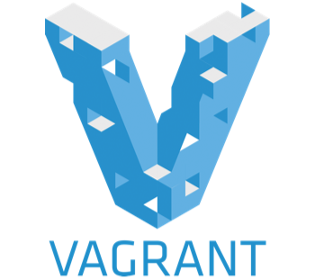
Vagrant
Vagrant automates the creation of virtual machines using infrastructure as code practices.
Started by Mitchell Hishimoto in 2010 as a personal project.
HashiCorp founded in 2012 for commercial support.
Allows a user to programmatically launch virtual machines using a definition file (Vagrantfile).
Launch one or many VMs on VirtualBox, VMWare, Hyper-V, Docker and AWS.
Works as a “wrapper” around virtualization software and written in Ruby.
Share complete virtual machines with a simple Vagrantfile.

Slide 51
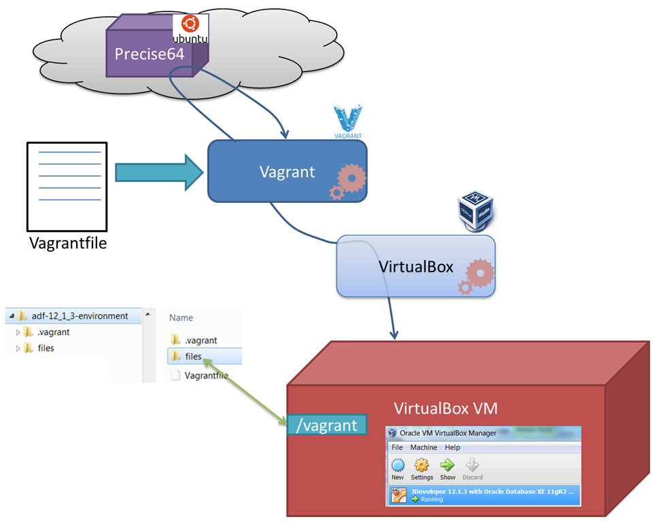
Vagrant architecture

Slide 52
Vagrant Commands
$ vagrant init <optional box>
Create a new Vagrantfile and working directory.
$ vagrant up
Launch a new VM using the Vagrantfile configuration.
$ vagrant ssh
Create an ssh connection to the VM.
$ vagrant destroy
Remove the VM.

Slide 53
Vagrant Hands-on
Create a new ubuntu VM
$ vagrant init ubuntu/trusty64
Review Vagrantfile configuration options.
Launch the new VM:
$ vagrant up
Review the VM ssh configuration:
$ vagrant ssh-config
SSH into the new VM:
$ vagrant ssh
Review the default shared directory:
$ cd /vagrant
$touch foo
Delete the VM:
$ vagrant destroy

Slide 54
Vagrant Hands-on
Review provisioning Vagrantfile
Launch the vm:
$ vagrant up
Watch provisioning process.
View webserver running on vm:
http://localhost:8081
Remove the virtual machine:
$ vagrant destroy

Slide 55
Homework
Assignment 3
Read Practice of Cloud Systems Administration Chapter 3
Read Overview of Amazon Web Services (December 2015)

